Slide 1
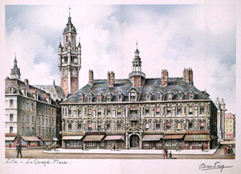
The Six Ages
of Library Collection Development
Ann Okerson, CRL

Slide 2
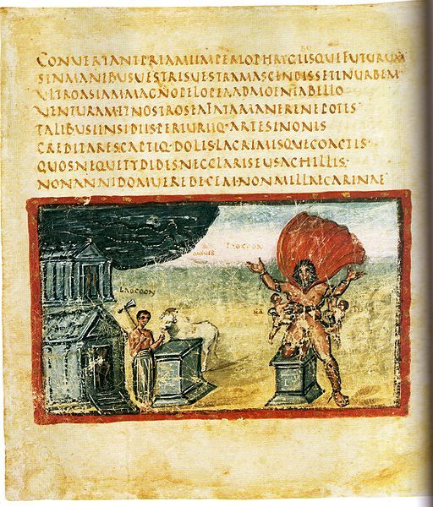
The Stone Age
Manuscripts
Monasteries
Hand Copying
Accumulation

Slide 3
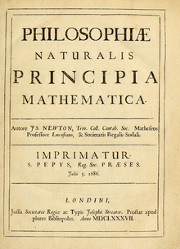
The Bronze Age
Printed books
National Libraries
Increased Mobility
Accumulation

Slide 4
The Iron Age
Serious technology tools
Union Catalogs
Interlibrary Loan
Accumulation

Slide 5
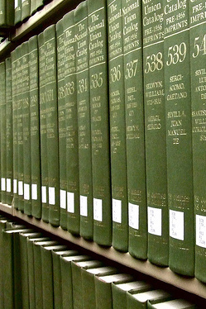
The Industrial Age
Post-war boom
Explosive growth
Automating old habits
Mass accumulation

Slide 6
The Information Age
Serials Crisis → Digital Information
Consortia
Economic/Legal Contention
Access over Accumulation

Slide 7
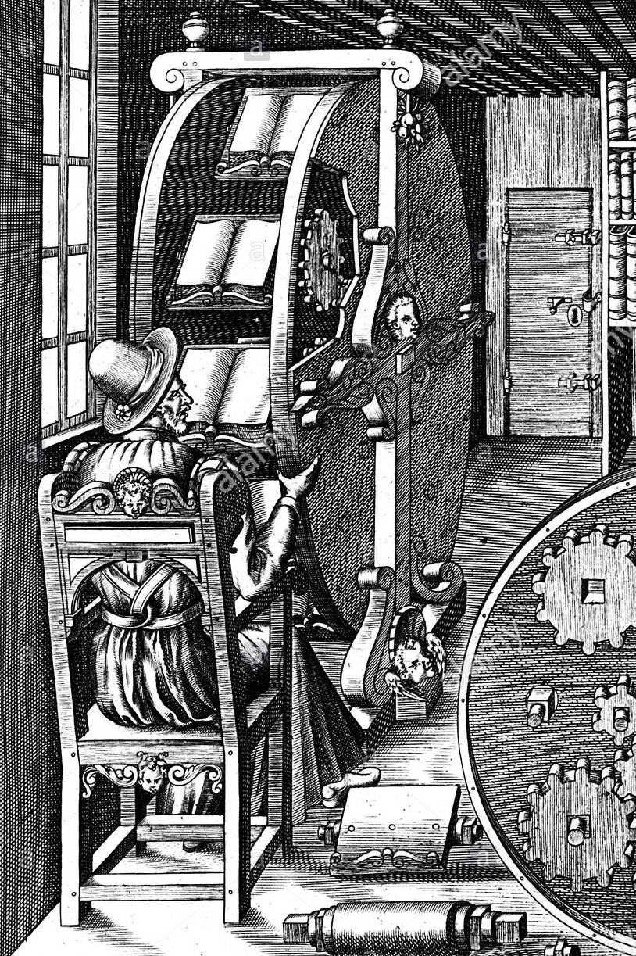
The Machine Age
Or should we call it:
The
Age
of
Machine
Reading?

